Slide 1
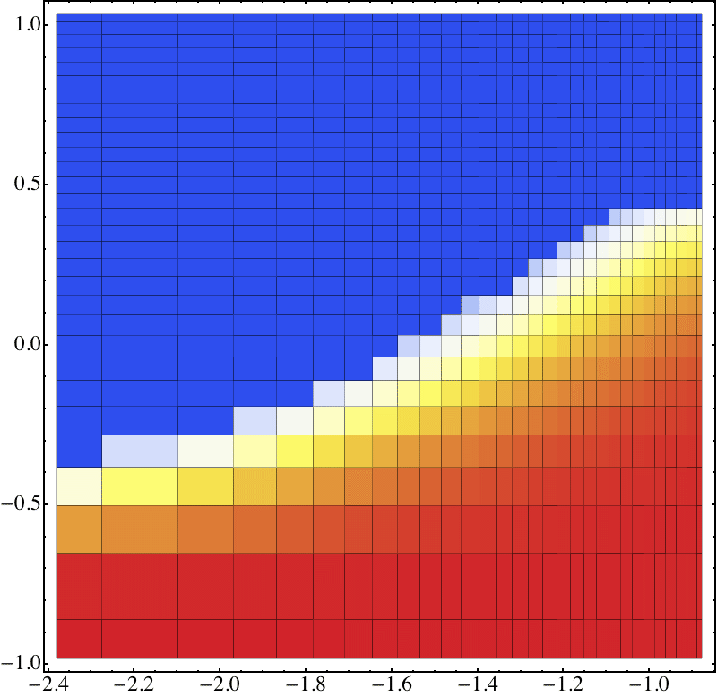
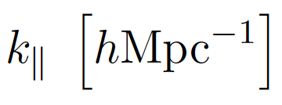
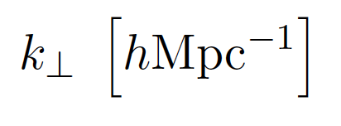
Foreground subtraction or foreground avoidance?
Adrian Liu, UC Berkeley
Notes:
What I want to discuss today is the possibility that we perhaps want to rethinking foreground subtraction a little bit. Rather than thinking about foreground subtraction, perhaps it would be safer to think about foreground avoidance. Foregrounds are scarily bright, and it might be better to make our measurements where they don’t really matter, rather than to confront them head-on.
Integration time etc.

Slide 2
Vision
Notes:
But first, let’s step back and talk about what the vision is. Why do we care about this?

Slide 3
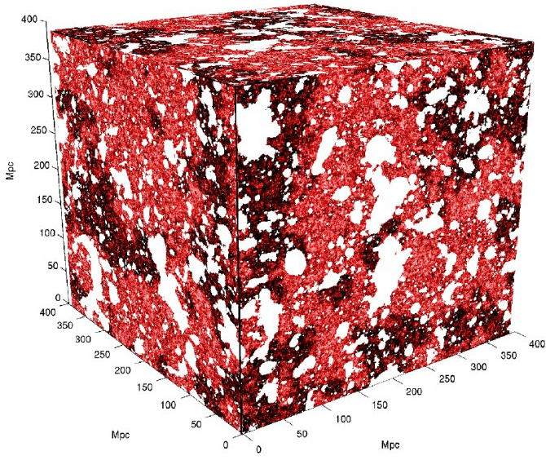
The redshifted 21cm line is possibly our only direct probe of reionization and the dark ages
21cmFAST, Mesinger et al.
Notes:
As all the speakers today have already alluded to, the redshifted 21cm line is probably our only direct probe of the IGM during reionization and the dark ages before. From simulations of the 21cm brightness temperature, we know that this will tell us a lot about the first luminous sources in our Universe, particularly how they ionized their surroundings, causing these “bubbles” in the 21cm emission. Being able to characterize these patterns will tell us about the first sources. And we’ve started characterizing them, for instance by measuring the power spectrum, which will be the focus of this talk.
X_i = 0.3, z =8.

Slide 4
Current power spectrum limits from experiments like PAPER…
Parsons, AL et al. 2013, 1304.4991
Notes:
And we’ve started to make these measurements. For instance, here’s an example power spectrum measured by the PAPER experiment at z=7.7, which Jonnie showed earlier. A number of groups that we’ve heard from this morning have started to place limits on the power spectrum. The black points are the measurements, the turquoise a calculation of expected instrumental thermal noise level for this measurementt, and the magenta a fiducial model. We of course have some ways to go before we hit the level of the signal, because there are challenges to overcome. I would say that there are two challenges here, which are illustrated by this plot. We notice that there are qualitatively two different regimes here. Towards the right-hand-side of the plot, we have…
About 250 hrs.

Slide 5
…are sensitivity/integration time limited at high k…
Parsons, AL et al. 2013, 1304.4991
Notes:
…measurements that are consistent with zero, with variance consistent with what one might expect from thermal noise. Hopefully to push down we only need to integrate for longer. On the other hand, at low k, we have

Slide 6
…are likely limited by foreground contamination at low k.
Parsons, AL et al. 2013, 1304.4991
Notes:
On the other hand, at low k, we have measurements that are NOT consistent with zero. That’s not to say that we’ve made a detection of the cosmological signal, but rather that we’ve detected SOMETHING. In this case, we’ve simply made a very clear detection of contaminants, for instance

Slide 7
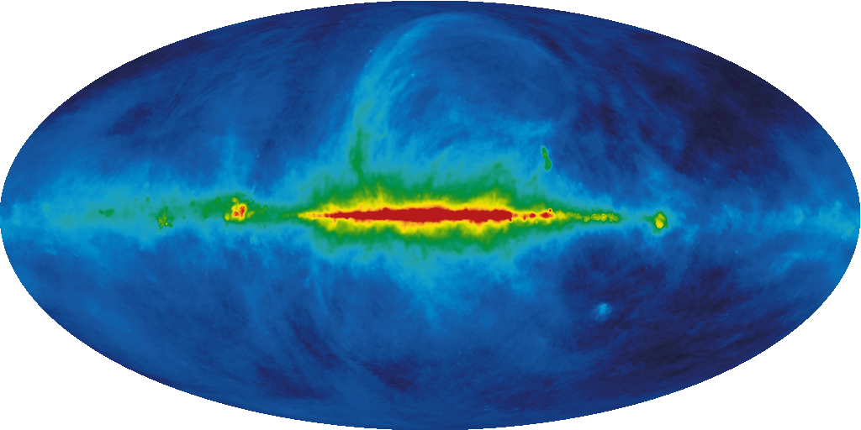
Foreground contamination is serious
Foregrounds ~ O(100 K); Signal ~ O(1-10 mK)
Notes:
Galactic synchrotron radiation, unresolved point sources, etc. This is a serious challenge, partly because the foregrounds are so much brighter than the signal, as many of the speakers today have already mentioned. But because it’s a harder problem than what we’ve dealt with before, even from a purely mathematical standpoint. To see this, let’s think about another cosmological probe that has to deal with foreground contamination.

Slide 8
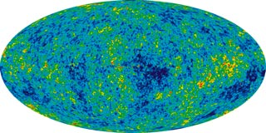
Cosmic Microwave Background
21cm Tomography
(See AL, Pritchard, Tegmark, Loeb 2013 PRD 87, 043002 for more details)
Notes:
The cosmic microwave background is another cosmological probe that requires the extraction of small fluctuations from underneath a large signal. There is a crucial difference between the CMB and 21cm surveys though. Whereas CMB experiments probe a 3D signal, with two spatial dimensions and a frequency axis to get a 2D map of just two spatial dimensions, in 21cm our final product is 3D. This means the CMB has an entire extra axis of redundant information that can help distinguish between foregrounds and signal, whereas this is not the case for 21cm tomography. Every dimension contains unique info for us. As a result, one can show that blind methods don’t work as well for 21cm tomography as they do for the CMB. If we want to fight foregrounds, we have to model them. Returning to the current status of measurements, then, we have two options.

Slide 9
Foreground subtraction
Work at low k.
Instrumental noise low.
Foreground modeling requirements extreme.
Parsons, AL et al. 2013, 1304.4991
Notes:
The first is to try to get a detection of the EoR signal at low k. This has the advantage of being the place where instrumental noise is low, as we can see from the turquoise curve. But one is foreground limited, so to proceed we need to do active foreground subtraction. We need to be able to model these foregrounds precisely enough so that we can subtract two large numbers to get a small number. Alternatively, we can…

Slide 10
Foreground avoidance
Work at high k.
Instrumental noise high.
Foreground modeling requirements easier.
Parsons, AL et al. 2013, 1304.4991
Notes:
Work at high k, where we have a priori reasons to expect that the foregrounds will be less bright, and it’s not so important to have a really good model of the foregrounds. But this is at the expense of high instrumental noise, and therefore lower sensitivity.

Slide 11
Foreground subtraction or foreground avoidance?
Notes:
That’s the vision. By the end of today’s talk I’d like to everyone to have a sense for what some of the more detailed trade-offs are.

Slide 12
Take-home messages
A robust framework for the quantification of errors is essential for a detection of the power spectrum.
“Optimal” methods may be overly aggressive and susceptible to mis-modeling of foregrounds.
Assuming that foregrounds are Gaussian-distributed may lead to an underestimation of errors.
Foreground avoidance may be a more robust way forward.
Notes:
We’ll look at what it takes to really be successful at foreground subtraction, and we’ll see that it’s really important to have an optimal framework for power spectrum estimation that quantifies errors. We’ll build our methods around those that are optimized for dealing with Gaussian errors. However, we’ll see that the non-Gaussian nature of foregrounds doesn’t compromise this too much. What does matter is that the optimal methods can be overly aggressive in how they minimize their errors, and can result in a lack of robustness to a mismodeling of foregrounds. My final take-home message is thus going to be that foreground avoidance may be the better way forward.

Slide 13
Necessary ingredients for successful foreground mitigation
Notes:
Let’s begin by talking about the necessary ingredients for successful foreground mitigation. In my view there are three.

Slide 14
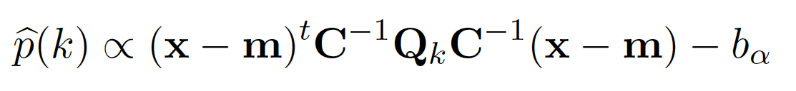
Ingredients for foreground mitigation
A power spectrum estimation framework that fully propagates error covariances.
Foreground model
Fourier, binning
Data
Model uncertainty
Bias removal
Notes:
The second copy to the right of this matrix basically squares the result to form a power spectrum. But squaring means that all foreground and noise residuals become positive, which biases our result. So we need to model and remove this bias.
Now, this seems like an awful lot of machinery to describe what’s a fairly simple process of forming a power spectrum. But we use all this baggage for two reasons. First, this quadratic form is guaranteed to give the smallest possible error bars if the uncertainties are Gaussian. In addition, it provides a nice way to quantify the statistical properties of the estimator. For example, one of the things it allows us to compute is the set of window functions, which tells us what linear combination of the true power spectrum is being probed by our estimator.

Slide 15
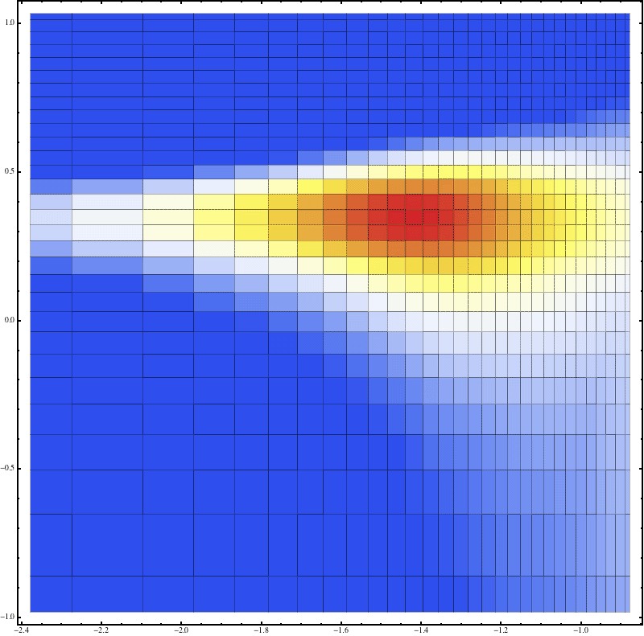
10⁰
10¹
10⁻⁵⁰
10⁰
10⁻¹
10⁻¹⁰⁰
10⁻²
10⁻¹
AL 2013, in prep.
Notes:
Just like a number of speakers before me, I’m going to plot quantities related to the power spectrum on this kperp-kpara plane, decomposing the power spectrum into Fourier modes perpendicular to the line of sight and parallel to the line of sight. Now, what window functions tell me, is…

Slide 16
10⁰
10¹
10⁻⁵⁰
10⁰
10⁻¹
10⁻¹⁰⁰
10⁻²
10⁻¹
AL 2013, in prep.
Notes:
That when my estimator says it has probed the power spectrum at these k-values, it has really taken in information from all around it. Admittedly, you can tell from the log-color scale here that the window functions are quite narrow, but when you have a foreground power spectrum that is potentially 10 orders of magnitude brighter than your cosmological scale, small effects matter.

Slide 17
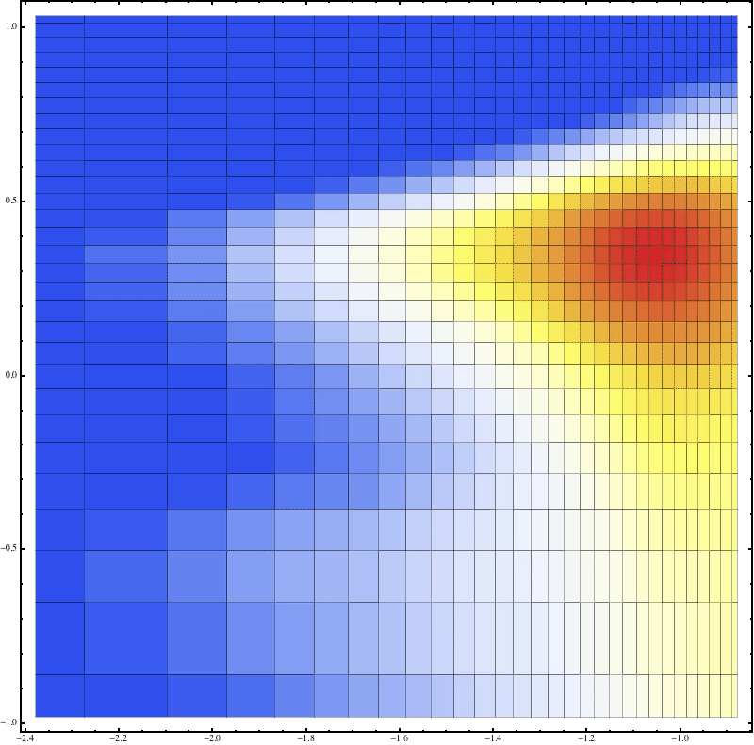
10⁰
10¹
10⁻⁵⁰
10⁰
10⁻¹
10⁻¹⁰⁰
10⁻²
10⁻¹
AL 2013, in prep.
Notes:
Here’s another window function, this one centered at higher k-perp but the same kparallel. Comparing the two, what you see is that at higher k-perp, our estimator takes in data from a much more elongated swath of k-parallel values. This is another way of saying that we have a wedge. The window functions are telling us that at high kperp, we have large amounts of leakages between kpara bins.

Slide 18
Ingredients for foreground mitigation
A power spectrum estimation framework that fully propagates error covariances.
  Window functions.
  Covariant errors.
Notes:
So that’s one of the things that our framework provides us with. The window functions, that tell us what linear combination of the truth we’ve measured. Along the same sort of theme, our formalism also delivers fully covariant errors. Rather than just providing error bars, it’s crucial to quantify the correlations between errors. As an example of why this is important, consider what happens after we’ve formed a power spectrum in this kperp-kpara space.

Slide 19
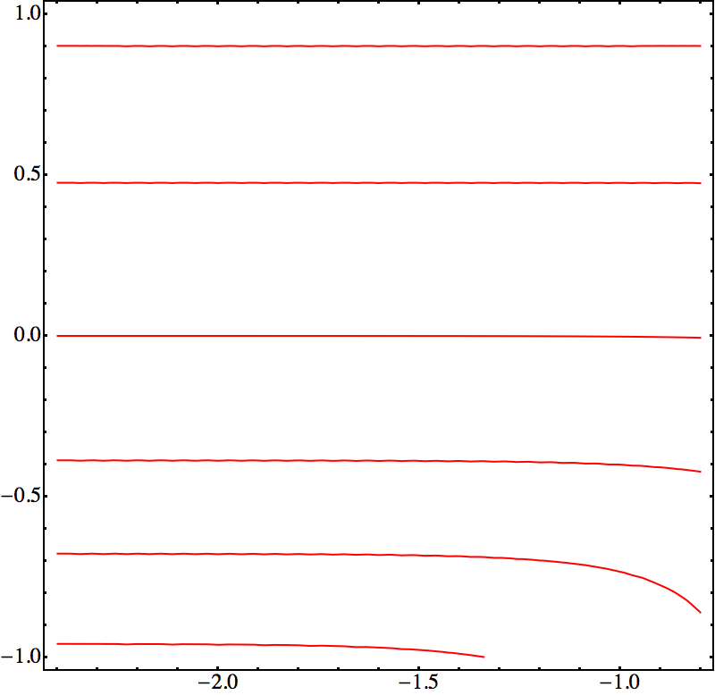
Along constant k-tracks, error properties differ
k~3 hMpc⁻¹
k~0.4 hMpc⁻¹
k~0.1 hMpc⁻¹
Notes:
From a standpoint of cosmology, we have an isotropic power spectrum, which means we bin along contours of this plane. But we just saw that the error properties and correlations differ quite significantly. And particularly at high kperp, we expect these tracks to be correlated, as we saw before.

Slide 20
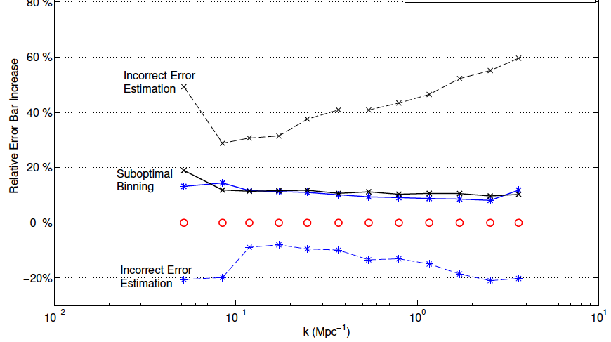
Ignoring error correlations can yield larger error bars or mistaken detections
80%
60%
40%
Relative error bar increase
20%
0%
-20%
10⁻²
10⁻¹
10⁰
10¹
k [Mpc⁻¹]
Dillon, AL, Williams et al. 2013, 1304.4229
Notes:
Ignoring these correlations can, depending on one’s exact power spectrum algorithm, result in error bars that are estimated to be larger than they should be. Or in some cases, and more dangerously, it can result in errors to be UNDERESTIMATED, potentially leading to a false detection. These aren’t huge effects, but again, these small effects are going to be important, particularly in the next few years when we go from upper limits to marginal detections.

Slide 21
Ingredients for foreground mitigation
A power spectrum estimation framework that fully propagates error covariances.
  Window functions.
  Covariant errors.
Notes:
So again, we need a way to properly take into account the errors AND CORRELATIONS when we estimate power spectra. Now, none of this would be relevant if we didn’t take into account all the input errors into our estimation process. Put another way, we need…

Slide 22
Ingredients for foreground mitigation
A power spectrum estimation framework that fully propagates error covariances.
  Window functions.
  Covariant errors.
A good foreground model including error covariances (see, e.g., Trott et al. 2012, ApJ 757, 101).
Foreground model
Model uncertainty
Notes:
Not just a model of the foregrounds, but also a model of the uncertainties in the model, including off-diagonal correlations. These quantities appear explicitly in the optimal estimator here, but the case for doing this was also elegantly stated in Cath’s paper here. It’s insufficient to just look at residuals from a foreground subtraction simulation, unless you’re willing to Monte Carlo to get a sense for the errors. Otherwise, you need a fully covariant formulation.

Slide 23
Ingredients for foreground mitigation
A power spectrum estimation framework that fully propagates error covariances.
  Window functions.
  Covariant errors.
A good foreground model including error covariances (see, e.g., Trott et al. 2012, ApJ 757, 101).
A method for propagating foreground properties through instrumental effects (e.g. chromatic beams).
Notes:
We’ve also got to have a way to see how all these effects look when propagated through an instrument. It takes some work, but that can be built into the formalism in a covariant way too, almost entirely analytically.

Slide 24
10⁰
10¹
10⁻⁵⁰
10⁰
10⁻¹
10⁻¹⁰⁰
10⁻²
10⁻¹
AL 2013, in prep.
Notes:
For instance, here is an example “wedge-plot” that people have been showing earlier. It captures the inherent chromaticity that one gets by surveying the sky with an interferometer, and here we’re showing the leakage of flat-spectrum, unresolved point sources from the k_parallel = 0 mode to higher k_parallels. These bright parts are thus expected to be foreground-dominated, whereas higher up the errors are going to be instrumental-noise dominated, although that’s not shown here. Foreground avoidance means working up here, where we’re noise-dominated. Foreground subtraction means finding a way to remove this down here. The fabulous dynamic range that one can get in this plot comes partly from the almost-fully analytic treatment that includes the instrumental effect. Provide a beam model, an input foreground power spectrum, and up to a single 1D-integral, all this can be reduced to a mostly-analytic formula. So aside from power spectrum estimation, this might also be useful for theory papers looking to put in some realistic foreground and instrumental effects.

Slide 25
Ingredients for foreground mitigation
A power spectrum estimation framework that fully propagates error covariances.
  Window functions.
  Covariant errors.
A good foreground model including error covariances (see, e.g., Trott et al. 2012, ApJ 757, 101).
A method for propagating foreground properties through instrumental effects (e.g. chromatic beams).
Notes:
This is what we need then, to mitigate foregrounds effectively. We need a covariant framework that propagates errors properly, a good foreground model, and a method for including instrumental effects in this framework. Once we have these, it’s well-defined what the optimal power spectrum and it’s associated error properties.

Slide 26
Foreground subtraction or foreground avoidance?
Notes:
Now that we have the tools, we can begin to answer the question of whether we should try our best to model and remove foregrounds, or whether we should just practice foreground avoidance.

Slide 27
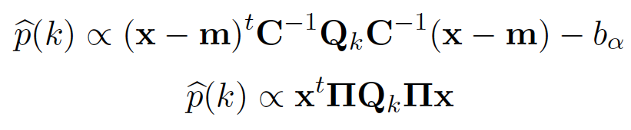
Subtraction
Avoidance
Projection matrix, e.g. delay transform
Notes:
As for avoidance, what I mean is that we don’t directly model the foregrounds. Instead, we make a generic cut like the delay transform that Jonnie talked about this morning, equivalent to projecting out some data, and for the delay transform, also equivalent to working outside the wedge, where we expect the errors to be noise-dominated.
In comparing these two, it’s basically a matter of precision versus robustness. Foreground avoidance requires less exquisite modeling, but if this modeling can be done, the optimal quadratic estimator is guaranteed, by construction, to give the smallest error bars. Indeed, suppose

Slide 28
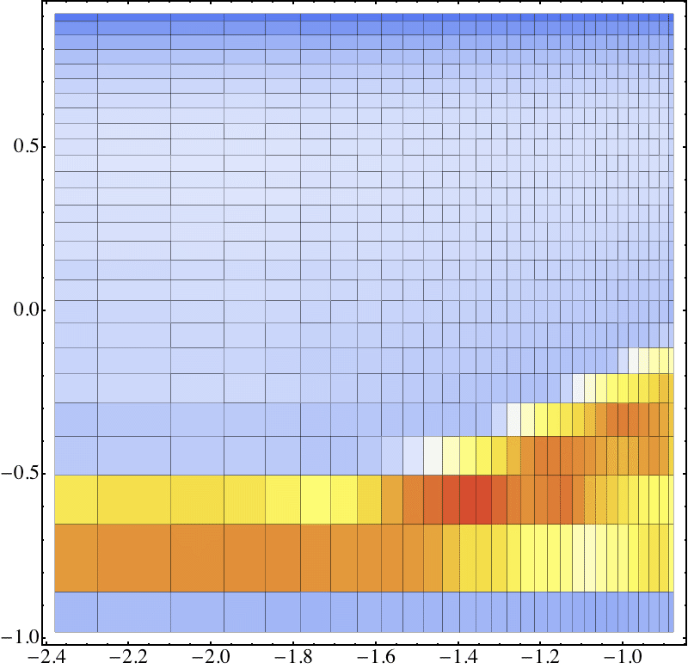
10^{2.5}
Error(avoid)
Error(sub)
10⁰
10¹
10⁻¹
10⁰
10⁻²
10⁻¹
AL 2013, in prep.
Notes:
…I were to plot the ratio of the errors, basically the factor by which the errors are larger for an avoidance-only strategy rather than a subtraction, the result is indeed

Slide 29
10^{2.5}
Error(avoid)
Error(sub)
10⁰
10¹
10⁻¹
10⁰
10⁻²
10⁻¹
AL 2013, in prep.
Notes:
…I were to plot the ratio of the errors, basically the factor by which the errors are larger for an avoidance-only strategy rather than a subtraction, the result is indeed greater than unity everyone in this plane. The benefits of this are particularly pronounced deep in the foreground-dominated wedge, which is not particularly surprising, since with the avoidance strategy we were explicitly just giving up on this region.
How exactly does the subtraction algorithm achieve this? Though it’s not the whole story, we can get some clues by looking at the window functions.

Slide 30
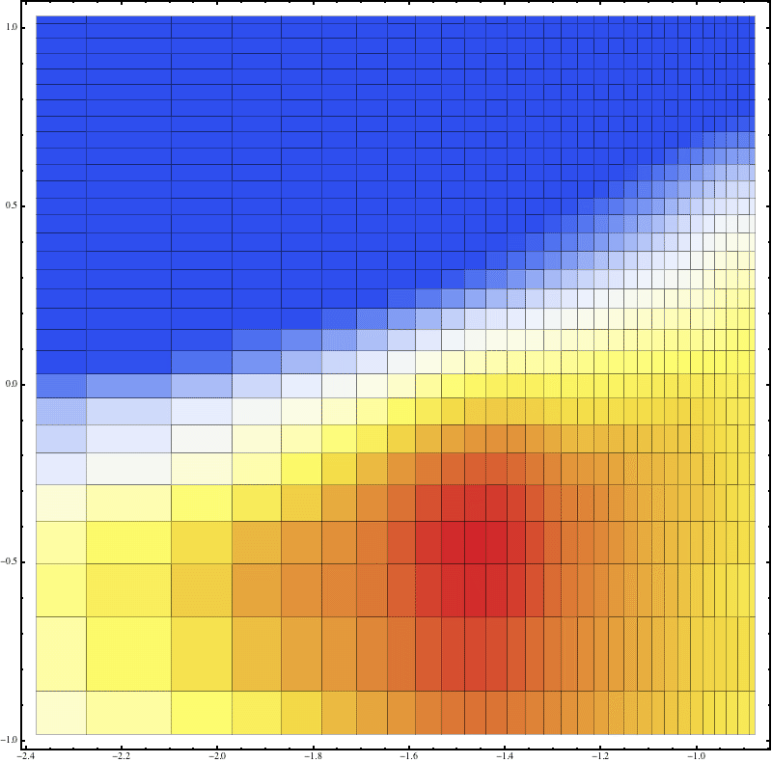
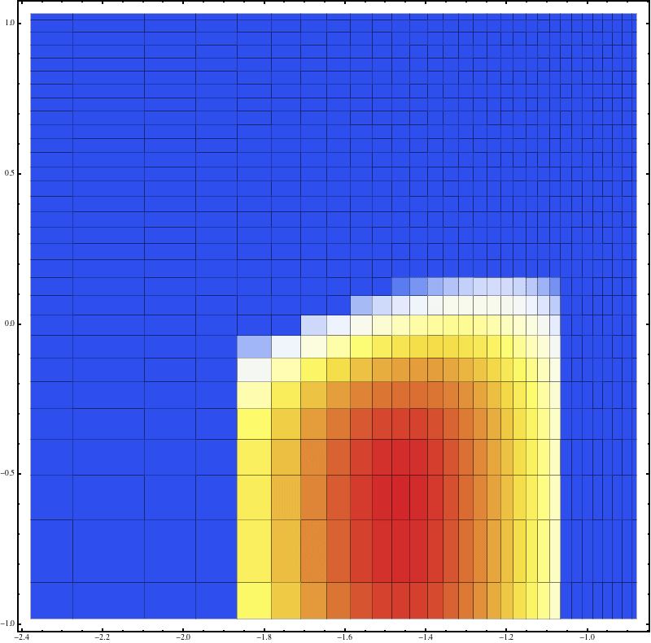
Subtraction
Avoidance
AL 2013, in prep.
Notes:
What’s immediately obvious is that the window functions for the subtraction case are much broader. What’s going on? Remember that the window functions tell us what linear combination of the truth we’re probing. One way to think about them, then, is to say that they essentially define the binning width of our measurement. We know that binning can help us achieve higher signal-to-noise, and the optimal prescription goes for a very aggressive sort of binning as a result. This is fine as long as our foreground models are correct, because the various matrix operations know precisely which linear combinations of various bits of data to put together in a high-wire act to get the smallest error bars. The danger, however, is that with such broad window functions, if your foregrounds are somewhat mismodeled, you can end up with foregrounds leaking all over the place, ruining the clean regions that should just be instrumental noise dominated.
In fact, suppose we get the amplitude of some flat-spectrum point sources wrong. The resulting leakage is greater for the subtraction case.

Slide 31
Leakage from mismodeled foregrounds more extended for subtraction than for avoidance
10¹
10⁰
Avoidance
10⁰
10⁻⁵⁰
10⁻¹⁰⁰
10⁻¹
10⁻¹
10⁻²
AL 2013, in prep.
Notes:
Here’s the expected leakage from the avoidance case. And if we flip to the aggressive subtraction, we get

Slide 32
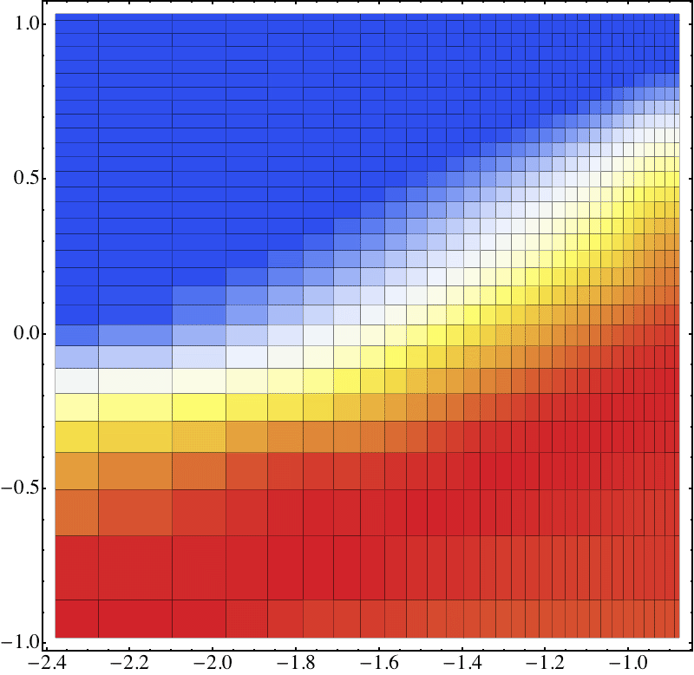
Leakage from mismodeled foregrounds more extended for subtraction than for avoidance
10¹
10⁰
Subtraction
10⁰
10⁻⁵⁰
10⁻¹⁰⁰
10⁻¹
10⁻¹
10⁻²
AL 2013, in prep.
Notes:
This. We clearly leak to higher values. So in the event that are models aren’t exactly right, things can in fact be worse for the so-called optimal approach. Formally, getting the model a little wrong actually is a second-order effect in the estimator, but the foregrounds are SO bright compared to the cosmological signal that even second-order effects matter.

Slide 33
Non-Gaussianity?
Notes:
I’d like to end by discussing yet another shortcoming of the aggressive method I outlined. And that’s the issue of non-Gaussianity. The estimator that I wrote down is the minimum variance form only if the fluctuations in the foregrounds are Gaussian. Unfortunately, foregrounds are FAR from Gaussian.

Slide 34
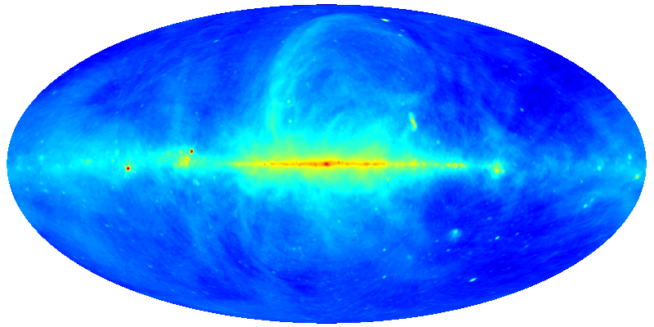
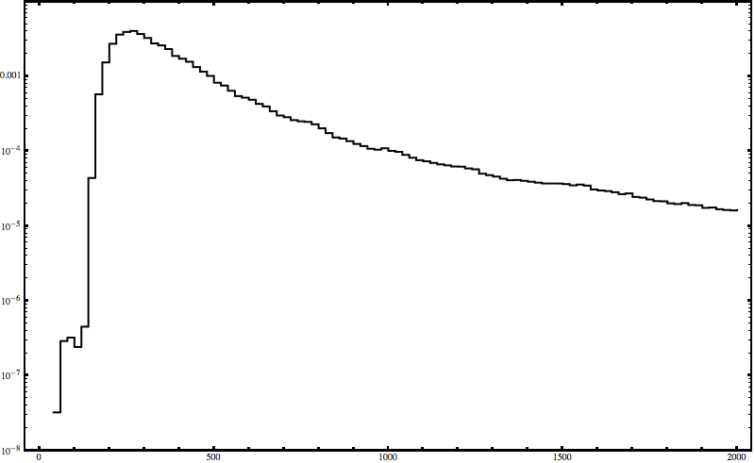
Foregrounds are highly non-Gaussian
Histogram
de Oliveira-Costa 2008, MNRAS 388, 247
Log[p(T)]
T
Notes:
What I mean by the fact that foregrounds are non-Gaussian is that if I take an empirical foreground model and plot of histogram of the temperatures in the various pixels, I get something that doesn’t look like a Gaussian at all.

Slide 35
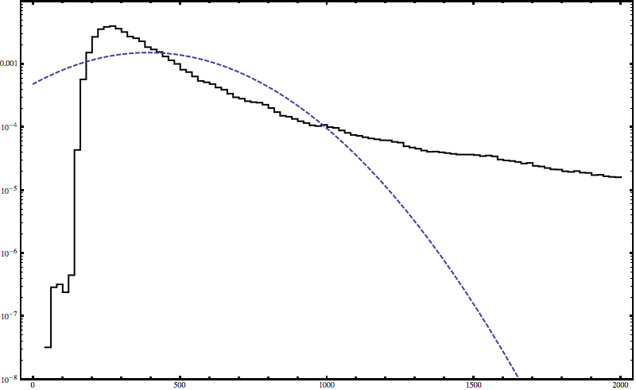
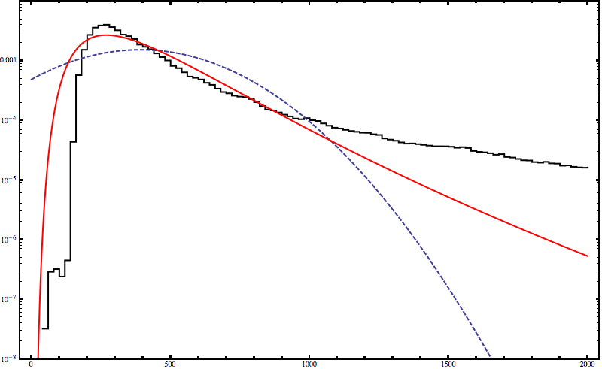
10⁻²
10⁻⁴
p(T)
Log-norm
10⁻⁶
Gaussian
10⁻⁸
0
1000
2000
T [K]
AL 2013, in prep.
Notes:
A log-normal fit seems to do better. It’s not so surprising that it does better, since physically we expect a lot of these sources to have a power-law spectrum, and if we imagine power-law spectra with Gaussian-distributed spectral indices, we end up with a log-normal distribution. There’s clearly still an unexplained component on the bright end, but as a toy model to see what the effects of non-Gaussianity might be, let’s imagine that the foregrounds really are log-normal distributed.

Slide 36
Assuming Gaussianity doesn’t bias the estimator
Pick b to ensure cancellation
Notes:
As a toy example, suppose I were interested in the k=0 mode of the power spectrum. That’s basically the variance. There’s a contribution from the signal and from the foregrounds. I only want the contribution from the signal, though, which means I have to subtract off this foreground variance with my bias subtraction term. That’s fine---I can do that whether I assume the errors are Gaussian or not, because with sufficiently good modeling I can pick the bias term to equal the variance of the foregrounds., Gaussian or not. But when I calculate the error bars or the standard deviation of this power spectrum estimator, I need to square. So…

Slide 37
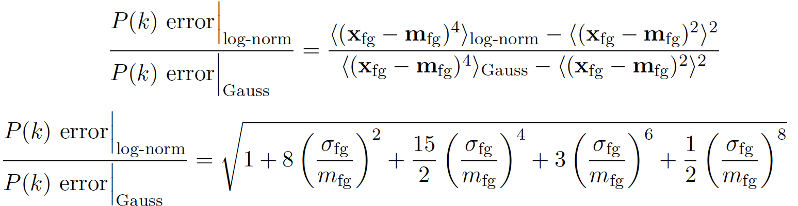
Assuming Gaussianity causes the error to be underestimated
Notes:
The resulting error depends on the FOURTH moment, which I can’t adjust to be the same for the log-normal and the Gaussian. So if we work out the actual error bars knowing that the foregorunds are log-normal distributed and compare it to the errors predicted by the Gaussian approximation, we get

Slide 38

Assuming Gaussianity causes the error to be underestimated
Notes:
…this handy expression that depends on the spread of the foreground pdf and the mean value, which for our simple toy model evaluates to 1.9. So we underestimate our errors by roughly a factor of 2.

Slide 39
Take-home messages
A robust framework for the quantification of errors is essential for a detection of the power spectrum.
“Optimal” methods may be overly aggressive and susceptible to mis-modeling of foregrounds.
Assuming that foregrounds are Gaussian-distributed may lead to an underestimation of errors.
Foreground avoidance may be a more robust way forward.

